Slide 1




[WRO] 4 spotkanie Microsoft Azure User Group Poland we Wrocławiu
Piotr Rogala
Partnerzy

Slide 2

Sponsor spotkania:
Web: https://www.objectivity.co.uk/

Slide 3

Dzisiaj do rozdania
3 Vouchery o wartości $100
ważne do końca grudnia 2016
30dni na wykorzystanie

Slide 4
Info
Jesteśmy dostępni na:
Meetup:
http://www.meetup.com/Microsoft-Azure-Users-Group-Poland/events
Facebook:
https://www.facebook.com/groups/azureugpl
Szukamy osób chętnych do prezentacji i dzielenia się wiedzą

Slide 5
Dziś
Session 1: Azure AD (Marek Zalewski)
Session 2: Media Services (Piotr Rogala)
Session 3: Automatyzacja za pomocą Automation Account (Mirek Choma)
Open Spaces with beer

Slide 6
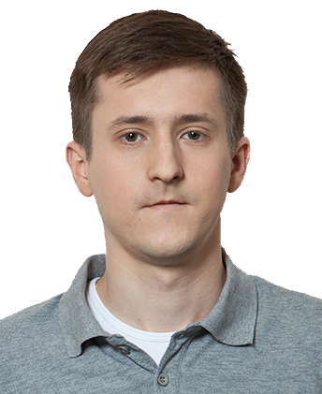
About Me
Current working in IBM
Blog: http://justcloud.pl
FB Page: http://facebook.com/justcloudpl
Group leader:
Microsoft Azure User Group Poland
http://azureug.org
Getting involve Azure solutions

Slide 7
Files, links, presentation
http://maugp.justcloud.pl

Slide 8

Marek Zalewski
Azure AD

Slide 9

Azure Media Services

Slide 10
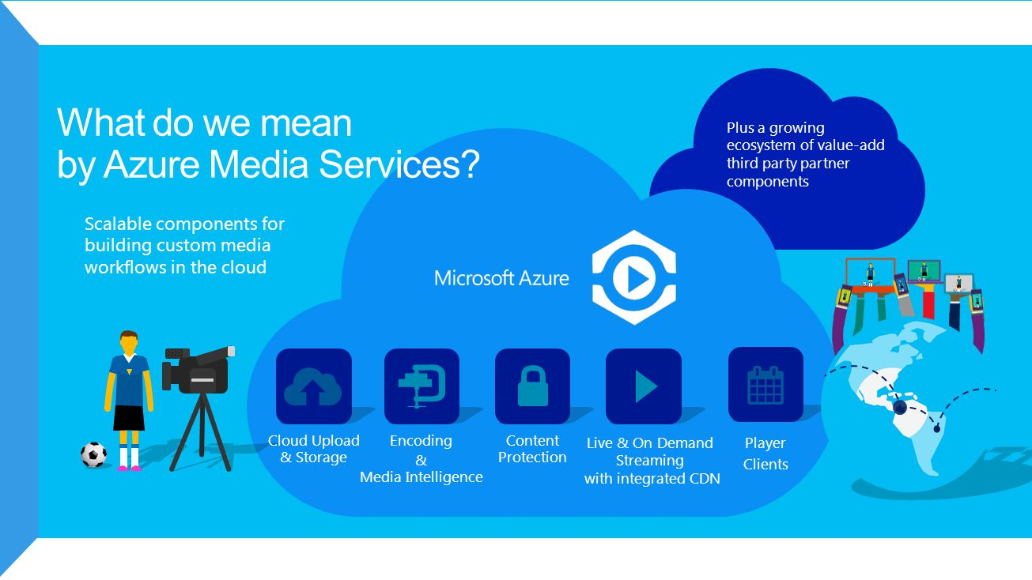

Slide 11
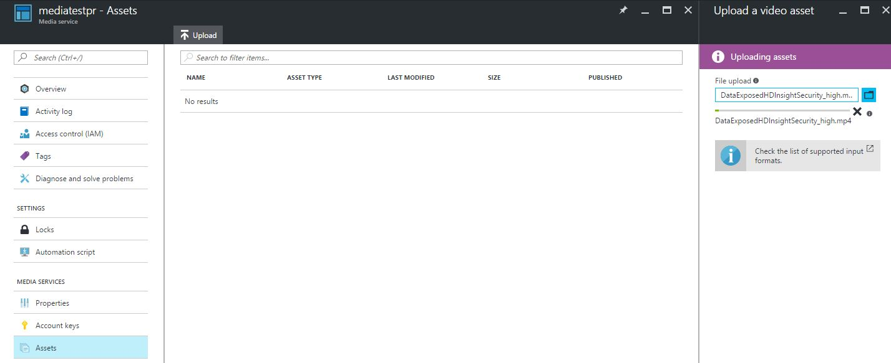
Upload Assets

Slide 12
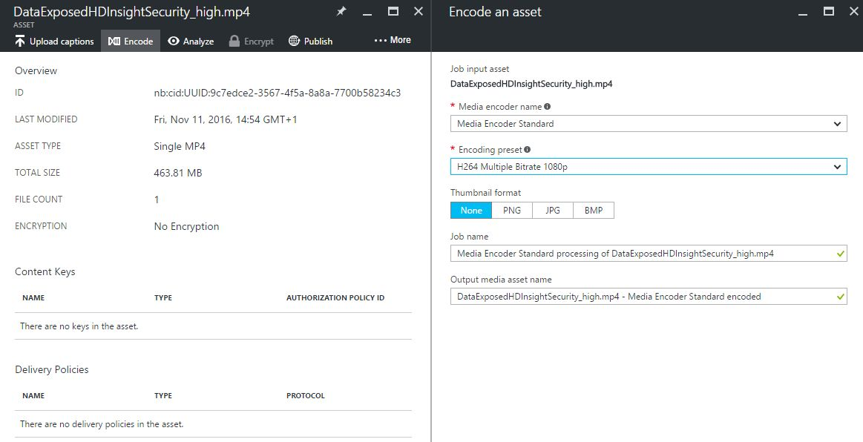
Encode

Slide 13
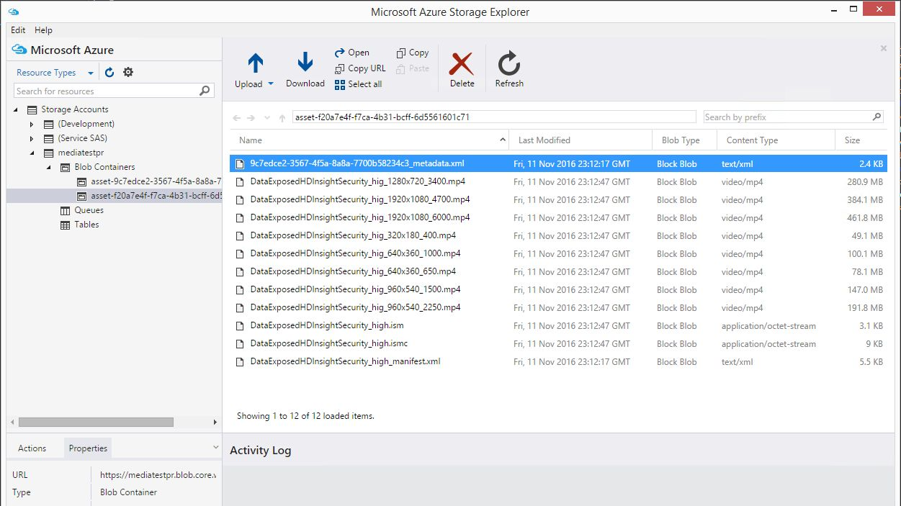
Encode

Slide 14
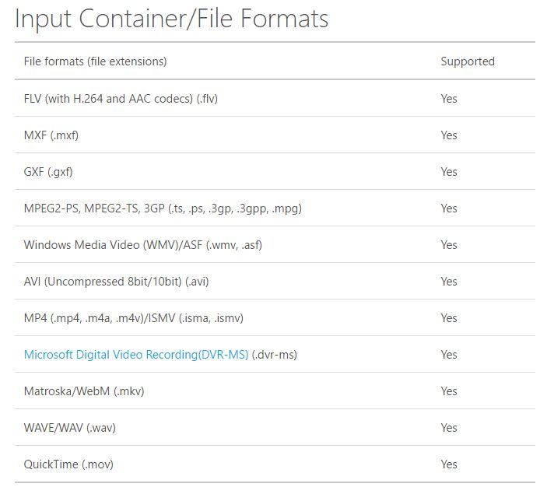
Media Encoder
https://azure.microsoft.com/en-us/documentation/articles/media-services-media-encoder-standard-formats/

Slide 15
Azure Media Service Explorer
Dostęp do Media Services bez konieczności używania portalu
Łatwy update plików
Łatwy dostęp do tworzenia streamingu
Łatwe sprawdzenie zajętości dysku
Przydatne linki

Slide 16
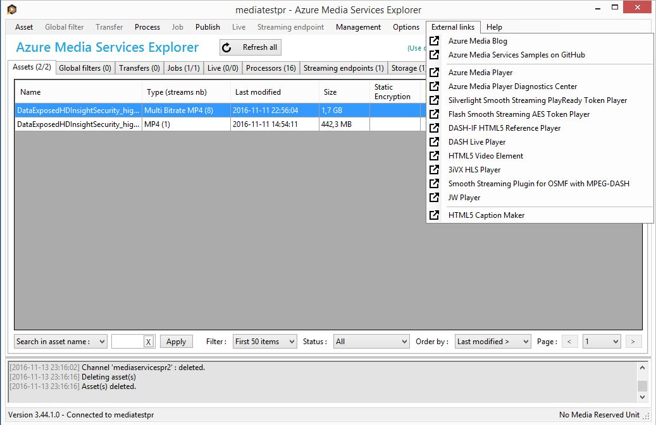
Azure Media Service Explorer
https://github.com/Azure/Azure-Media-Services-Explorer/releases/tag/v3.44.1.0

Slide 17
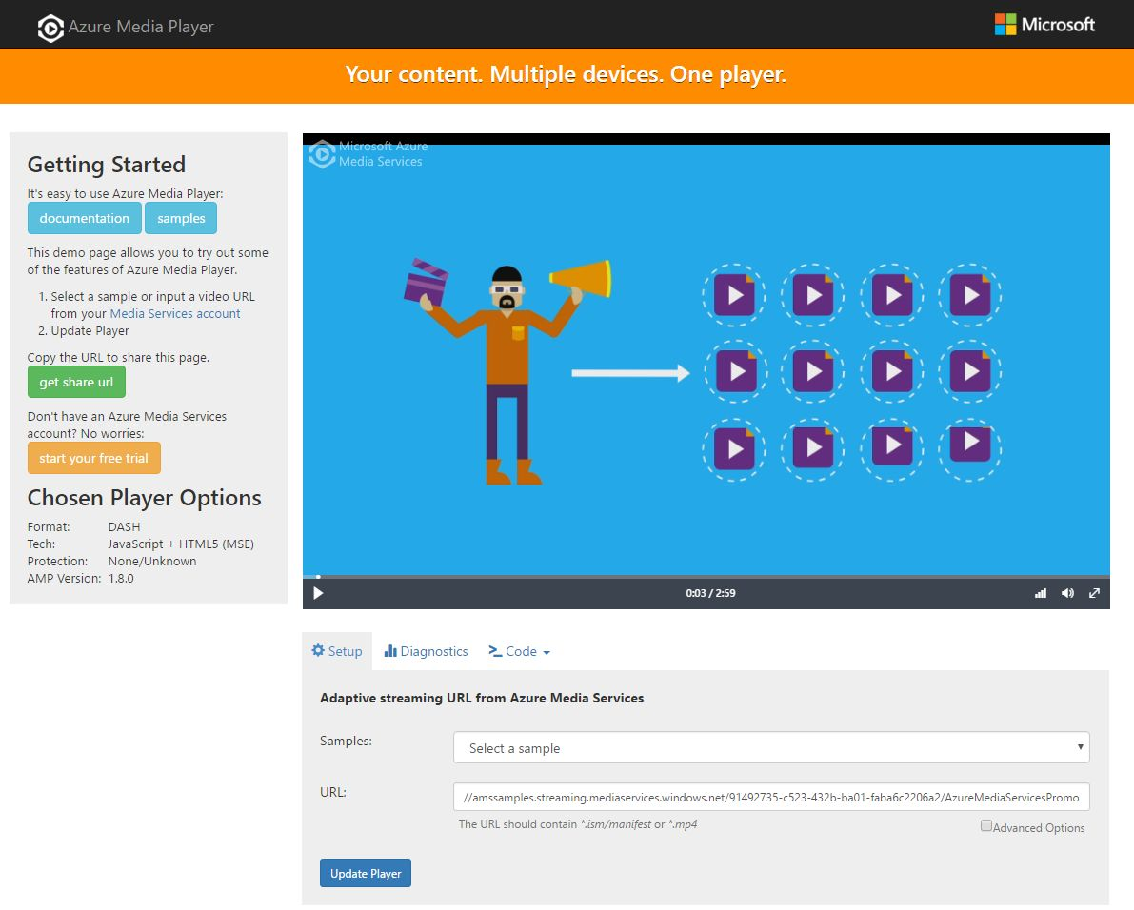
Azure Media Player
http://ampdemo.azureedge.net/azuremediaplayer.html

Slide 18
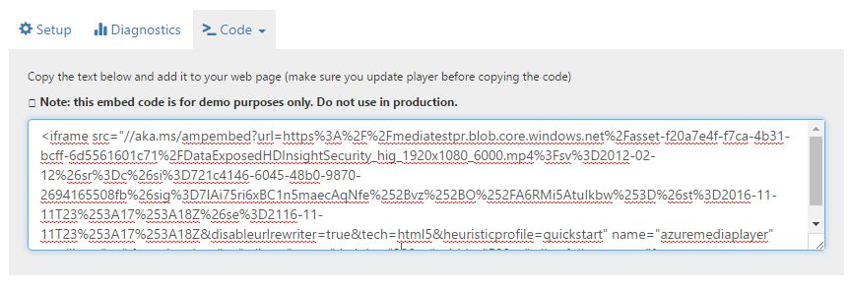
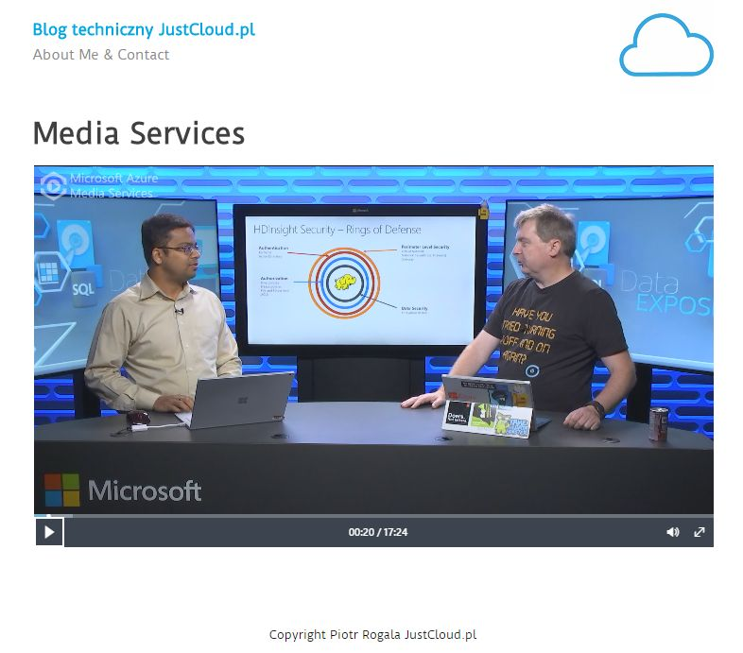
Dodanie playera na stronę

Slide 19
Player Clients
Azure Media Player
Flash
HTML5
JW Player
DASH Live Player
Silverlight

Slide 20
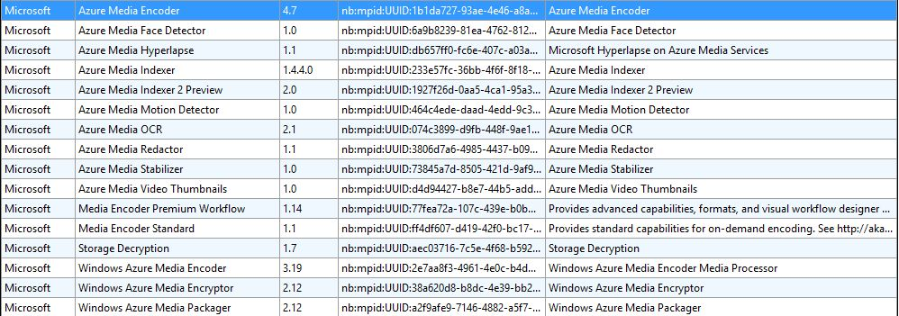
Azure Media Services Analytics
Indexer – przeszukiwanie ścieżek z napisami
Hyperlapse – stabilizacja obrazu*
Detekcja ruchu
Wykrywanie twarzy
Wideo podsumowania – sugerowanie interesujących fragmentów
Rozpoznawanie znaków OCR
Scalable face redaction – rozmazywanie twrzy
https://www.youtube.com/watch?v=SOpwHaQnRSY

Slide 21
Aplikacje do Live Streaming-u
WireCast (płatna)
Adobe Flash Media Live Encoder (płatna)
Aplikacja musi wspierać protokół RTMP (Real-Time Messaging Protocol)
https://azure.microsoft.com/en-us/blog/azure-media-services-rtmp-support-and-live-encoders/

Slide 22







Dynamic Packing
Traditional Encode and Package
Package
HLS
Encode
Package
Video sources
Multi-bitrates Mp4
Smooth
Streaming
Origin Server
Dynamic Packaging
Origin Server
Dynamic
Packaging
Encode
HLS
Smooth
Streaming
Video sources
Multi-bitrates Mp4
DASH
Input format: Mp4 or Smooth Streaming
Output format: Smooth Streaming , Http-Live-Streaming (v4 and v3), MPEG-DASH

Slide 23
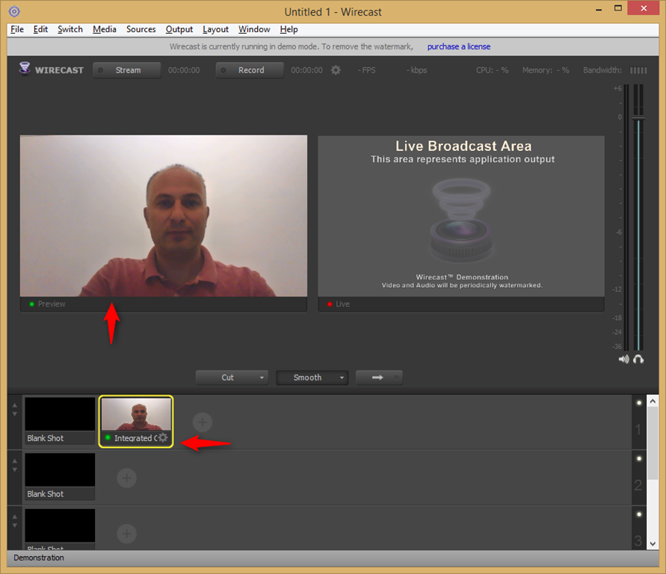
Wirecast

Slide 24
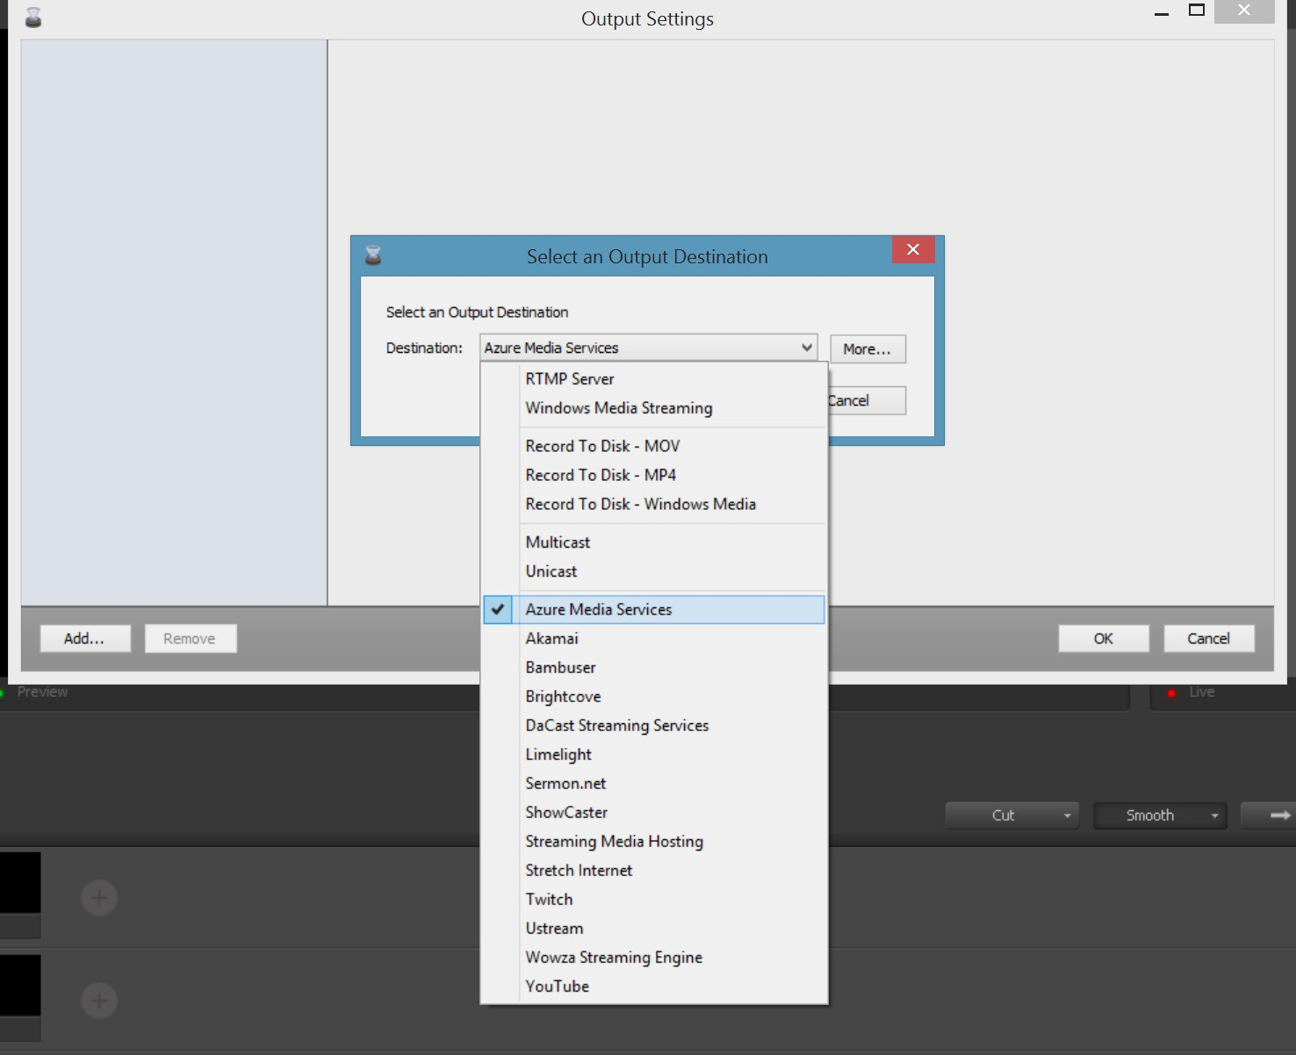
Notes:
http://www.davevoyles.com/2015/04/16/live-streaming-html5-video-using-azure-media-services/

Slide 25
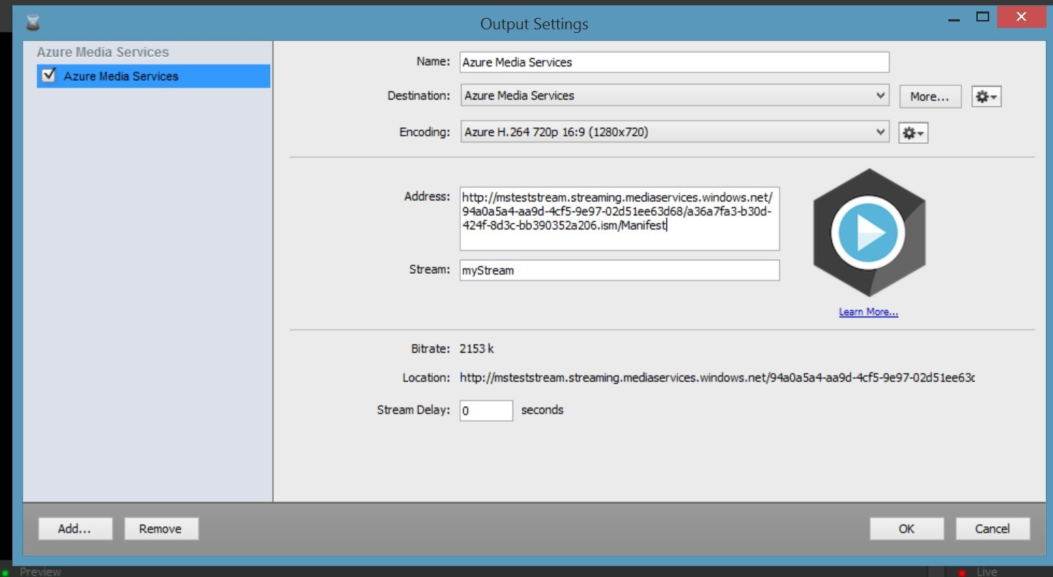

Slide 26
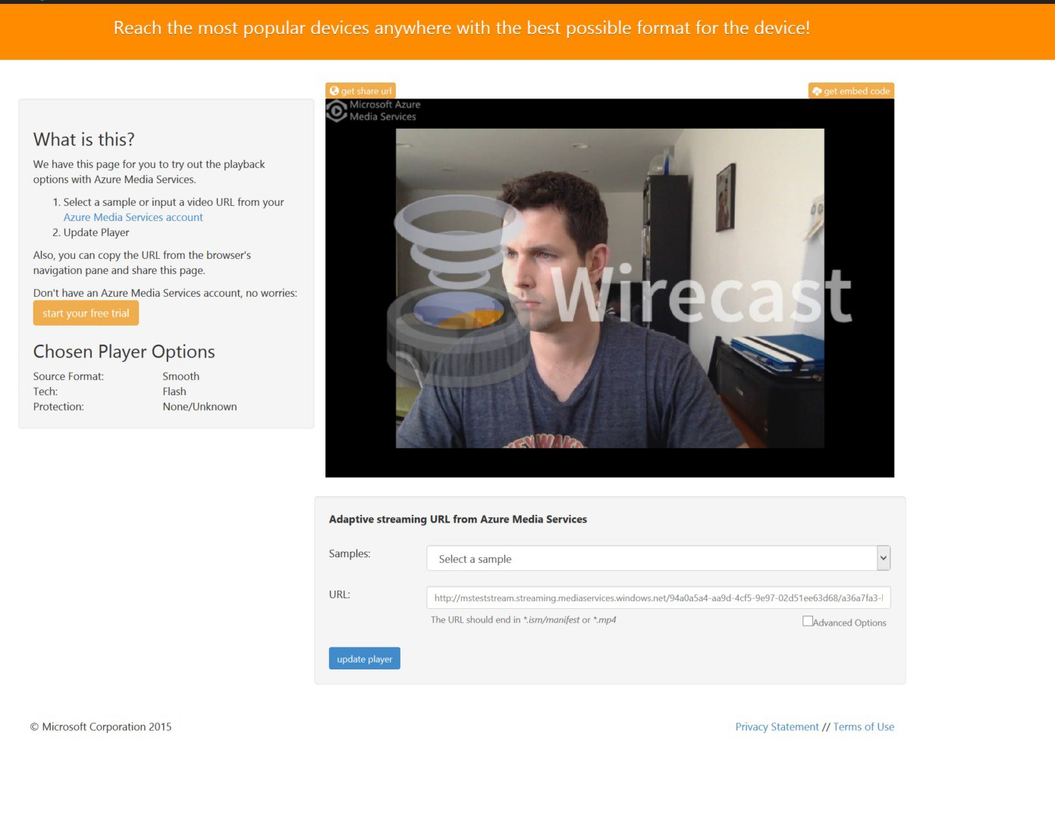

Slide 27

Koszty
Płacimy za:
Encode (GB)
Przechowywanie video (GB)
Uruchomienie dynamicznego kodowania (Dzień)
Live Streaming (Minuta)

Slide 28
Dziękuję za uwagę!
Questions?
Piotr Rogala
Partnerzy

Slide 29

Jęśli interesujesz się zagadnieniami Azure Cloud…..
Cloud Operations Engineer
Country: Poland, Wrocław
We are Unit4, a leading provider of enterprise applications empowering people in service organizations. We are on a mission, because we no longer accept the digital downgrade that people experience when they swap their personal devices for their work ones. We create business software that works the way people want, not the other way around.
SaaS Operations will use DevOps methology to work with both cross functional scrum teams as well as customer facing support groups. A SaaS Engineer supports the deployment, and operations of Unit4 Global scale products. The SaaS engineer collaborates with his/her teammates to monitor, handle incidents, configuration management and to improve solutions in Unit4 cloud platform. In this role, the engineer will work to deploy and operate our Cloud Service, help automate and streamline our operations and processes, and build and maintain tools for deployment, monitoring and operations. The engineer will troubleshoot and resolve issues in our customer facing production environments.
APPLY AT:
https://careers.unit4.com/job/cloud-operations-engineer-270225.html

